Slide 1
THEORY OF COMPUTATION

Slide 2
Introduction
It is the study of abstract machines and the computation problems that can be solved using these machines.
The abstract machine is called the automata.
Automata is the machine which takes some string as input and this input goes through a finite number of states and may enter in the final state.
The automaton consists of states and transitions. The State are represented by circles, and the Transitions are represented by arrows.

Slide 3
Basic Terminologies
Symbol
It is an atomic unit, such as a digit, character, letter, etc.
For example,
a, b, c,……………z
0, 1, 2,…………..9
+, -, *, %,…………special characters
Alphabet
It is a finite set of symbols, denoted by Σ.
For example,
∑ = {0, 1} is an alphabet of binary digits

Slide 4
Basic Terminologies (Continued)
String
It is a finite sequence of symbols selected from some alphabet, generally denoted as w.
For example,
01101 is a string from the binary alphabet Σ={0,1}
aaba is a string from the alphabet Σ={a, b}.
Kleen closure
It is the infinite set of all possible strings of all possible lengths including є.
For example,
For ∑ = {0, 1} we have set of strings as ∑* = {є, 0, 1, 01, 10, 00, 11, 10101,…}.

Slide 5
Basic Terminologies (Continued)
Positive closure
It is the infinite set of all possible strings of all possible lengths excluding є.
For example,
For ∑ = {0, 1} we have set of strings as ∑⁺ = {1, 01, 10, 00, 11, 10101,…}.
Language
It is a subset of Σ*or set of strings, chosen from some Σ*, denoted by L.
Finite language – finite number of strings.
Eg: If L1 = {set of string of length 2} then {00, 01, 10, 11} over the alphabet ∑ = {0, 1}.
Infinite language – infinite number of strings.
Eg: If L2 = {set of string that starts with 0} then {0, 00, 01, 010, 011 …..} over the alphabet ∑ = {0, 1}.

Slide 6
Finite Automata
Finite automata are used to recognize patterns.
It takes the string of symbol as input and changes its state accordingly. When the desired symbol is found, then the transition occurs.
At the time of transition, the automata can either move to the next state or stay in the same state.
Finite automata have two states, Accept state or Reject state. When the input string is processed successfully, and the automata reached its final state, then it will accept.

Slide 7
Formal definition of Finite Automata
A finite automaton is a collection of 5-tuple
M=(Q, ∑, δ, q0, F)
Where,
Q: Finite set called states
Σ: Finite set called alphabets
δ: Q × Σ → Q is the transition function
q0 ∈ Q is the start or initial state
F: Final or accept state

Slide 8
Representation of Finite Automata
Finite Automata can be represented as follows −
Transition diagram
Transition table
Transition function

Slide 9
Transition diagram
It is a directed graph associated with the vertices of the graph corresponding to the state of finite automata.
a
a, b
q₁
q₂
q₀
b
b
q₂
a
Transition diagram for L that accepts set of strings over {a, b} that contains the substring bb

Slide 10
Transition table
It is basically a tabular representation of the transition function that takes two arguments (a current state & a symbol) and returns a value (the ‘next state’).
State/Input symbol | a | b
-> q0 | q0 | q1
q1 | q0 | q2
q2 | q2 | q2
Transition table for L that accepts set of strings over {a, b}
that contains the substring bb

Slide 11
Transition function
The transition function is denoted by δ. The two parameters mentioned below are the passes to this transition function.
Current state
Input symbol
The transition function returns a state which can be called as the next state.
δ (current_state, current_input_symbol) = next_state
For example, δ(q0,a)=q0

Slide 12
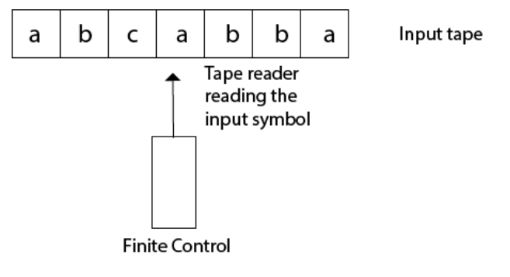
Finite Automata model
Input tape: It is a linear tape having some number of cells. Each input symbol is placed in each cell.
Finite control: The finite control decides the next state on receiving particular input from input tape. The tape reader reads the cells one by one from left to right, and at a time only one input symbol is read.

Slide 13
Types of Automata
The different types of Finite Automata are as follows −
Finite Automata without output
Deterministic Finite Automata (DFA).
Non-Deterministic Finite Automata (NFA or NDFA).
Non-Deterministic Finite Automata with epsilon moves (e-NFA or e-NDFA).
Finite Automata with Output
Moore machine.
Mealy machine.

Slide 14
Deterministic Finite Automata (DFA)
Deterministic refers to the uniqueness of the computation.
The finite automata are deterministic FA, if the machine reads an input string one symbol at a time.
In DFA, there is only one path input from the current state to the next state.
It does not accept the null move, i.e., it cannot change state without any input.
It can contain multiple final states.

Slide 15
Formal definition of DFA
A DFA is a collection of 5-tuples
M=(Q, Σ, δ,q0,F)
Q: finite set of states
∑: finite set of the input symbol
q0: initial state
F: final state
δ: Transition function
Transition function can be defined as:
δ: Q x ∑→Q

Slide 16
Example
L = Set of all strings start with 0
The strings are 0, 01, 010, 011, 001 ….
0, 1
q0
q1
0
q1
1
0, 1
q2
Dead state/
Trap state

Slide 17
Non - Deterministic Finite Automata (NFA)
The finite automata are called NFA when there exist many paths for specific input from the current state to the next state.
NFA is defined in the same way as DFA but it contains multiple next states.
Every NFA is not DFA, but each NFA can be translated into DFA.

Slide 18
Formal definition of NFA
Non-deterministic finite automata is defined as a 5 tuple,
M=(Q, Σ, δ,q0,F)
Q: finite set of states
∑: finite set of the input symbol
q0: initial state
F: final state
δ: Transition function
Transition function can be defined as:
δ: Q x ∑→2^{Q}

Slide 19
Example
L = Set of all strings start with 0
The strings are 0, 01, 010, 011, 001 ….
0, 1
q0
q1
0
q1

Slide 20
Non-Deterministic Finite Automata with epsilon moves (ε -NFA).
An epsilon nondeterministic finite automaton (NFA) has null or epsilon transitions from one state to another.
The automaton may be allowed to change its state without reading the input symbol.
In diagrams, such transitions are depicted by labeling the appropriate arcs with ε.

Slide 21
Formal definition of ε-NFA
Non-deterministic finite automata with epsilon is defined as a 5 tuple,
M=(Q, Σ, δ,q0,F)
Q: finite set of states
∑: finite set of the input symbol
q0: initial state
F: final state
δ: Transition function
Transition function can be defined as:
δ: Q x (∑ U ∈)→2^{Q}

Slide 22
Example
L = Set of all strings start with 0
The strings are 0, 01, 010, 011, 001 ….
0,1
q0
q1
q1
0
ε
q2

Slide 23
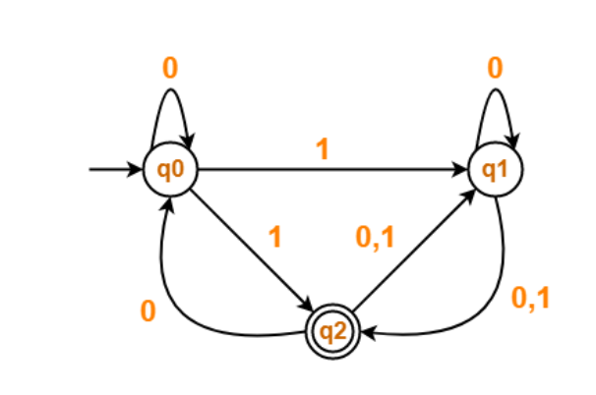
Conversion from NFA to DFA
Convert the following Non-Deterministic Finite Automata (NFA) to Deterministic Finite Automata (DFA)-

Slide 24
Conversion from NFA to DFA (Continued)
Solution
Transition table for the given Non-Deterministic Finite Automata (NFA) is
State / Alphabet | 0 | 1
→q0 | q0 | q1, q2
q1 | q1, q2 | q2
q2 | q0, q1 | q1

Slide 25
Conversion from NFA to DFA (Continued)
Step-01:
Let Q’ be a new set of states of the Deterministic Finite Automata (DFA).
Let T’ be a new transition table of the DFA.
Step-02:
Add transitions of start state q0 to the transition table T’.
State / Alphabet | 0 | 1
→q0 | q0 | {q1, q2}

Slide 26
Conversion from NFA to DFA (Continued)
Step-03:
New state present in state Q’ is {q1, q2}.
Add transitions for set of states {q1, q2} to the transition table T’.
State / Alphabet | 0 | 1
→q0 | q0 | {q1, q2}
{q1, q2} | {q0, q1, q2} | {q1, q2}

Slide 27
Conversion from NFA to DFA (Continued)
Step-04:
New state present in state Q’ is {q0, q1, q2}.
Add transitions for set of states {q0, q1, q2} to the transition table T’.
State / Alphabet | 0 | 1
→q0 | q0 | {q1, q2}
{q1, q2} | {q0, q1, q2} | {q1, q2}
{q0, q1, q2} | {q0, q1, q2} | {q1, q2}

Slide 28
Conversion from NFA to DFA (Continued)
Step-05:
Since no new states are left to be added in the transition table T’, so we stop.
States containing q2 as its component are treated as final states of the DFA.
Finally, Transition table for Deterministic Finite Automata (DFA) is-
State / Alphabet | 0 | 1
→q0 | q0 | {q1, q2}
{q1, q2} | {q0, q1, q2} | {q1, q2}
{q0, q1, q2} | {q0, q1, q2} | {q1, q2}

Slide 29
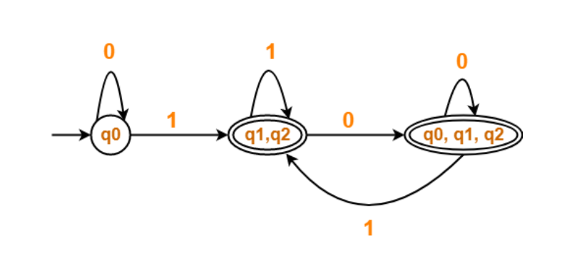
Conversion from NFA to DFA (Continued)
Now, Deterministic Finite Automata (DFA) may be drawn as

Slide 30
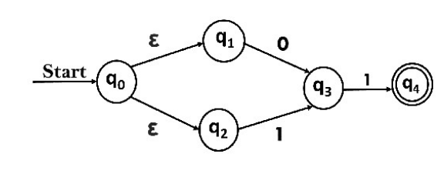
Conversion from ε-NFA to DFA
Convert the NFA with ε into its equivalent DFA.

Slide 31
Conversion from ε-NFA to DFA (Continued)
Solution
Let us obtain ε-closure of each state.
1. ε-closure {q0} = {q0, q1, q2}
2. ε-closure {q1} = {q1}
3. ε-closure {q2} = {q2}
4. ε-closure {q3} = {q3}
5. ε-closure {q4} = {q4}

Slide 32
Conversion from ε-NFA to DFA (Continued)
Now, let ε-closure {q0} = {q0, q1, q2} be state A.
Hence
δ'(A, 0) = ε-closure {δ((q0, q1, q2), 0) }
= ε-closure {δ(q0, 0) ∪ δ(q1, 0) ∪ δ(q2, 0) }
= ε-closure {q3}
= {q3} call it as state B
δ'(A, 1) = ε-closure {δ((q0, q1, q2), 1) }
= ε-closure {δ((q0, 1) ∪ δ(q1, 1) ∪ δ(q2, 1) }
= ε-closure {q3}
= {q3} = B.

Slide 33
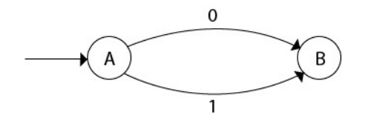
Conversion from ε-NFA to DFA (Continued)
The partial DFA will be
Now, δ'(B, 0) = ε-closure {δ(q3, 0) }
= ϕ
δ'(B, 1) = ε-closure {δ(q3, 1) }
= ε-closure {q4}
= {q4} i.e. state C

Slide 34
Conversion from ε-NFA to DFA (Continued)
For state C:
δ'(C, 0) = ε-closure {δ(q4, 0) }
= ϕ
δ'(C, 1) = ε-closure {δ(q4, 1) }
= ϕ

Slide 35
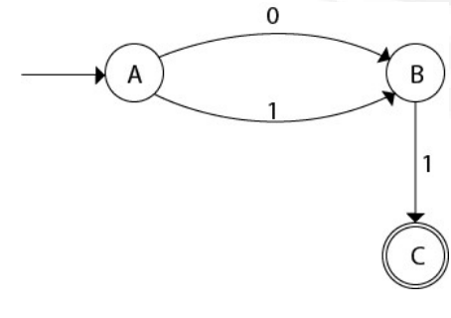
Conversion from ε-NFA to DFA (Continued)
The DFA will be,

Slide 36
Minimization of DFA
Minimization of DFA means reducing the number of states from given FA. Thus, we get the FSM(finite state machine) with redundant states after minimizing the FSM.
Steps to minimize the DFA:
Step 1: Remove all the states that are unreachable from the initial state via any set of the transition of DFA.
Step 2: Draw the transition table for all pair of states.
Step 3: Now split the transition table into two tables T1 and T2. T1 contains all final states, and T2 contains non-final states.

Slide 37
Minimization of DFA (Continued)
Step 4: Find similar rows from T1 such that:
δ (q, a) = p , δ (r, a) = p
That means, find the two states which have the same value for a and b and remove one of them.
Step 5: Repeat step 3 until we find no similar rows available in the transition table T1.
Step 6: Repeat step 3 and step 4 for table T2 also.
Step 7: Now combine the reduced T1 and T2 tables. The combined transition table is the transition table of minimized DFA.

Slide 38
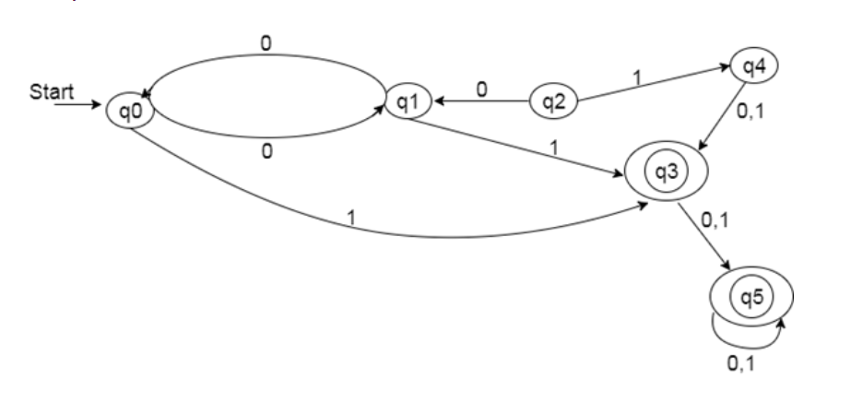
Example for minimization of DFA
Find the minimization for the following DFA

Slide 39
Example for minimization of DFA (Continued)
Solution
Step 1: In the given DFA, q2 and q4 are the unreachable states so remove them.
Step 2: Draw the transition table for the rest of the states.
State | 0 | 1
→q0 | q1 | q3
q1 | q0 | q3
q3 | q5 | q5
q5 | q5 | q5

Slide 40
Example for minimization of DFA (Continued)
Step 3: Now divide rows of transition table into two sets as:
1. One set contains those rows, which start from non-final states:
2. Another set contains those rows, which starts from final states.
State | 0 | 1
q0 | q1 | q3
q1 | q0 | q3
State | 0 | 1
q3 | q5 | q5
q5 | q5 | q5

Slide 41
Example for minimization of DFA (Continued)
Step 4: Set 1 has no similar rows so set 1 will be the same.
Step 5: In set 2, row 1 and row 2 are similar since q3 and q5 transit to the same state on 0 and 1. So skip q5 and then replace q5 by q3 in the rest.
State | 0 | 1
q3 | q3 | q3

Slide 42
Example for minimization of DFA (Continued)
Step 6: Now combine set 1 and set 2 as:
State | 0 | 1
→q0 | q1 | q3
q1 | q0 | q3
q3 | q3 | q3

Slide 43
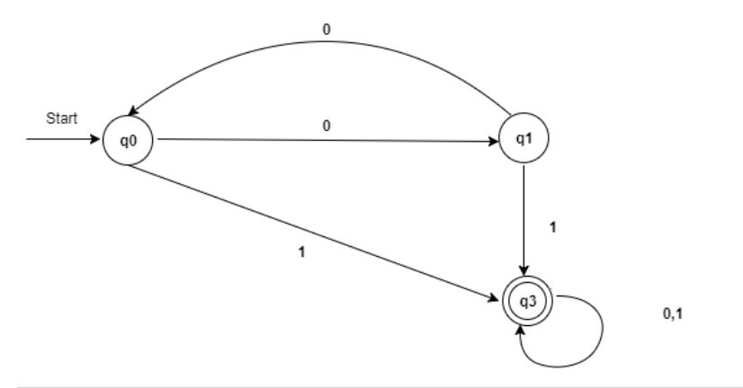
Example for minimization of DFA (Continued)
This is the the transition graph of minimized DFA.

Slide 44
Moore Machine
Moore machine is a finite state machine in which the next state is decided by the current state and the current input symbol.
The output symbol at a given time depends only on the present state of the machine.

Slide 45
Formal definition of Moore Machine
The Moore machine has 6 tuples
(Q, q0, Σ, O, δ, λ)
Where,
Q: Finite set of states
q0: Initial state of machine
Σ: Finite set of input symbols
O: Output alphabet
δ: Transition function where Q × Σ → Q
λ: Output function where Q → O

Slide 46
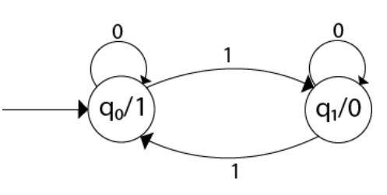
Example
Construct a Moore machine that determines whether an input string contains an even or odd number of 1's. The machine should give 1 as output if an even number of 1's are in the string and 0 otherwise.
Solution:
In this machine, state q1 accepts an odd number of 1's and state q0 accepts even number of 1's. There is no restriction on a number of zeros.

Slide 47
Mealy Machine
A Mealy machine is a machine in which output symbol depends upon the present input symbol and present state of the machine.
In the Mealy machine, the output is represented with each input symbol for each state separated by /.

Slide 48
Formal definition of Mealy Machine
The mealy machine can be described by 6 tuples
(Q, q0, Σ, O, δ, λ’)
Where,
Q: Finite set of states
q0: Initial state of machine
Σ: Finite set of input alphabet
O: Output alphabet
δ: Transition function, where Q × Σ → Q
λ': Output function, where Q × Σ →O

Slide 49
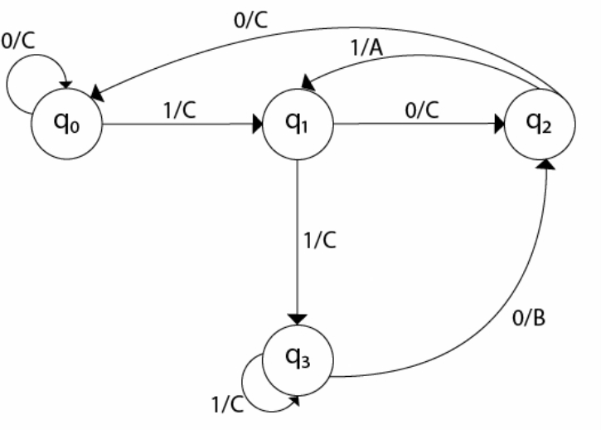
Example
Design a Mealy machine for a binary input sequence {0,1}. If the input has a substring 101, the output is A. If the input has substring 110, its output is B Otherwise, its output is C.
Solution

Slide 50
Conversion from Moore machine to Mealy Machine
Given below is the Moore machine that counts the occurrences of ‘abb’ in any input binary string over {a, b}. Convert it into equivalent mealy machine.
Σ={a, b} O= {0, 1}
b
a
q0/0
a
q1/0
b
q2/0
b
q3/1
a
a
b

Slide 51
Conversion from Moore machine to Mealy Machine (Continued)
Solution
Transition table for Moore machine
Q/Σ | a | b | O
q0 | q1 | q0 | 0
q1 | q1 | q2 | 0
q2 | q1 | q3 | 0
q3 | q1 | q0 | 1

Slide 52
Conversion from Moore machine to Mealy Machine (Continued)
Transition table for Mealy machine
Q/Σ | a | b
q0 | q1,0 | q0, 0
q1 | q1,0 | q2, 0
q2 | q1,0 | q3, 1
q3 | q1,0 | q0, 0

Slide 53
Conversion from Moore machine to Mealy Machine (Continued)
Equivalent mealy machine
b/0
a/0
q0
a/0
q1
b/0
q2
b/1
q3
a/0
a/0
b/0

Slide 54
Conversion from Mealy machine to Moore Machine
Given below is the mealy machine that prints ‘1’ whenever the sequence ‘aa’ or ‘bb’ is encountered in any input binary string over {a, b}. Convert the mealy machine to its equivalent moore machine.
a/1
q1
a/0
q0
b/0
a/0
q2
b/0
b/1

Slide 55
Conversion from Mealy machine to Moore Machine (Continued)
Solution
Transition table for Mealy machine
Q/Σ | a | b
q0 | q1,0 | q2, 0
q1 | q1,1 | q2, 0
q2 | q1,0 | q2, 1

Slide 56
Conversion from Mealy machine to Moore Machine (Continued)
Transition table for Moore machine
Q/Σ | a | b | O
q0 | q10 | q20 | 0
q10 | q11 | q20 | 0
q11 | q11 | q20 | 1
q20 | q10 | q21 | 0
q21 | q10 | q21 | 1

Slide 57
Conversion from Mealy machine to Moore Machine (Continued)
Equivalent Moore machine
a
q10/0
a
q11/1
a
b
q0/0
b
a
a
b
q20/0
q21/1
b
b

Slide 58
Regular Expression
The language accepted by finite automata can be easily described by simple expressions called Regular Expressions.
The languages accepted by some regular expression are referred to as Regular languages.
A regular expression can also be described as a sequence of pattern that defines a string.
Regular expressions are used to match character combinations in strings.

Slide 59
Examples
Write the regular expression for the language accepting all the string which are starting with 1 and ending with 0, over ∑ = {0, 1}.
Solution
In a regular expression, the first symbol should be 1, and the last symbol should be 0. The r.e. is R = 1 (0+1)* 0
Write the regular expression for the language containing the string in which every 0 is immediately followed by 11.
Solution
The regular expression will be R = (011 + 1)*

Slide 60
Conversion of RE to FA
ba*b
The strings accepted by the regular expression are bb, bab, baab, ..
a
q0
q0
b
q1
b
q2

Slide 61
Conversion of RE to FA (Continued)
(a+b)c
The strings accepted by the regular expression are ac and bc.
a
q1
q0
q0
c
q2
b

Slide 62
Conversion of RE to FA (Continued)
a(bc)*
The strings accepted by the regular expression are a, abc, abcbc, ..
c
q0
q0
q2
a
q1
b

Slide 63
CONTEXT FREE GRAMMAR

Slide 64
INTRODUCTION
Context-free grammar (CFG) is a type of formal grammar used to describe the syntax of a programming language or other formal language.
A CFG consists of a set of rules that specify how symbols can be combined to form valid strings of a language.
The rules are generally expressed in the form of a set of production rules, where each rule indicates how a single symbol may be replaced with a sequence of symbols.

Slide 65
The structure of a CFG consists of four components:
1. A set of terminal symbols is the characters used to form words or phrases in the language.
2. A set of non-terminal symbols, which are used to denote the different types of phrases or elements within the language
. 3. A set of production rules indicates how the symbols may be combined to form valid strings.
4. A start symbol is a symbol from which all valid strings begin.
A CFG can be used to define the syntax of a language and to generate valid strings of that language. In addition, it can be used to prove that certain strings are valid or invalid in the language.

Slide 66
INFORMAL COMMENTS
Context-free grammar is a notation for describing languages.
It is more powerful than finite automata or RE’s, but still cannot define all possible languages.
Useful for nested structures, e.g., parentheses in programming languages.
Basic idea is to use “variables” to stand for sets of strings (i.e., languages).
These variables are defined recursively, in terms of one another.
Recursive rules (“productions”) involve only concatenation.

Slide 67
EXAMPLES:
CFG for { 0n1n | n > 1}
Productions: S -> 01 S -> 0S1
Basis: 01 is in the language.
Induction: if w is in the language, then so is 0w1.

Slide 68
CFG FORMALISM
Terminals = symbols of the alphabet of the language being defined.
Variables = nonterminals = a finite set of other symbols, each of which represents a language.
Start symbol = the variable whose language is the one being defined.

Slide 69
Productions
A production has the form variable -> string of variables and terminals.
Convention:
A, B, C,… are variables.
a, b, c,… are terminals.
…, X, Y, Z are either terminals or variables.
…, w, x, y, z are strings of terminals only.
α, β, γ,… are strings of terminals and/or variables.

Slide 70
Example: Formal CFG
Here is a formal CFG for { 0n1n | n > 1}.
Terminals = {0, 1}.
Variables = {S}.
Start symbol = S.
Productions =
S -> 01
S -> 0S1

Slide 71
Derivations – Intuition
We derive strings in the language of a CFG by starting with the start symbol, and repeatedly replacing some variable A by the right side of one of its productions.
-> That is, the “productions for A” are those that have A on the left side of the ->.

Slide 72
Derivations – Formalism
We say αAβ => αγβ if A -> γ is a production.
Example: S -> 01;
S -> 0S1

Slide 73
Iterated Derivation
=>* means “zero or more derivation steps.”
Basis: α =>*α for any string α.
Induction: if α =>* β and β => γ, then α =>* γ .

Slide 74
Example: Iterated Derivation
S -> 01; S -> 0S1.
S => 0S1 => 00S11 => 000111.
So S =>* S; S =>* 0S1; S =>* 00S11; S =>* 000111.

Slide 75
SENTENTIAL FORMS
Any string of variables and/or terminals derived from the start symbol is called a sentential form.
Formally, α is a sentential form iff S =>* α.

Slide 76
Language of a Grammar
If G is a CFG, then L(G), the language of G, is {w | S =>* w}.
Note: w must be a terminal string, S is the start symbol.
Example: G has productions S -> ε and S -> 0S1.
L(G) = {0n 1 n | n > 0}.
Note: ε is a legitimate right side.

Slide 77
Context-Free Languages
A language that is defined by some CFG is called a context-free language.
There are CFLs that are not regular languages, such as the example just given.
But not all languages are CFL’s.
Intuitively: CFL’s can count two things, not three.

Slide 78
BNF Notation
Grammars for programming languages are often written in BNF (Backus-Naur Form ).
Variables are words in ; Example: <statement> .
Terminals are often multicharacter strings indicated by boldface or underline; for Example: while or WHILE.

Slide 79
BNF Notation
Symbol::= is often used for ->.
Symbol | is used for “or.”
Shorthand for a list of productions with the same left side.
Example: S -> 0S1 | 01 is shorthand for S -> 0S1 and S -> 01.
Symbol … is used for “one or more.”
Example: ::= 0|1|2|3|4|5|6|7|8|9
<unsigned integer> ::= <digit>…
⬥ Note: that’s not exactly the * of RE’s.
Translation: Replace α … with a new variable A and productions A -> A α | α .

Slide 80
Example: Kleene Closure
Grammar for unsigned integers can be replaced by:
U -> UD | D
D -> 0|1|2|3|4|5|6|7|8|9

Slide 81
BNF Notation: Optional Elements
Surround one or more symbols by […] to make them optional.
Example: <statement> ::= if <condition> then <statement> [; else <statement> ]
Translation: replace [α ] with a new variable A with productions A -> α | ε.
Example: Grammar for if-then-else can be replaced by:
S -> iCtSA
A -> ;eS | ε

Slide 82
Leftmost and Rightmost Derivations
Derivations allow us to replace any of the variables in a string.
Leads to many different derivations of the same string.
By forcing the leftmost variable (or alternatively, the rightmost variable) to be replaced, we avoid these “distinctions without a difference.”
Say wA α =>lm w β α if w is a string of terminals only and A -> β is a production.
Also, α =>*lm β if α becomes  by a sequence of 0 or more =>lm steps.

Slide 83
PUSH DOWN AUTOMATA(PDA)

Slide 84
INTRODUCTION OF PUSH DOWN AUTOMATA:
Pushdown Automata is a finite automata with extra memory called stack which helps Pushdown automata to recognize Context Free Languages
It “remember” only a finite amount of information, whereas a PDA can “remember” an infinite amount of (certain types of) information, in one memory-stack

Slide 85
Formal Definition of a PDA
A pushdown automaton (PDA) is a seven-tuple:
M = (Q, Σ, Г, δ, q₀, z₀, F)
Q A finite set of states
Σ A finite input alphabet
Г A finite stack alphabet
q₀ The initial/starting state, q₀ is in Q
z₀ A starting stack symbol, is in Г // need not always remain at the bottom of stack
F A set of final/accepting states, which is a subset of Q
δ A transition function, where
δ: Q x (Σ U {ε}) x Г –> finite subsets of Q x Г*

Slide 86
Consider the various parts of δ:
Q x (Σ U {ε}) x Г –> finite subsets of Q x Г*
Q on the LHS means that at each step in a computation, a PDA must consider its’ current state.
Г on the LHS means that at each step in a computation, a PDA must consider the symbol on top of its’ stack.
Σ U {ε} on the LHS means that at each step in a computation, a PDA may or may not consider the current input symbol, i.e., it may have epsilon transitions.
“Finite subsets” on the RHS means that at each step in a computation, a PDA may have several options.
Q on the RHS means that each option specifies a new state.
Г* on the RHS means that each option specifies zero or more stack symbols that will replace the top stack symbol, but in a specific sequence.

Slide 87
Two types of PDA transitions:
δ(q, a, z) = {(p₁,γ₁), (p₂,γ₂),…, (p_{m},γ_{m})}
Current state is q
Current input symbol is a
Symbol currently on top of the stack z
Move to state p_{i} from q
Replace z with γ_{i} on the stack (leftmost symbol on top)
Move the input head to the next input symbol
:
p₁
a/z/ γ₁
q
a/z/ γ₂
p₂
a/z/ γ_{m}
p_{m}

Slide 88
Two types of PDA transitions:
δ(q, ε, z) = {(p₁,γ₁), (p₂,γ₂),…, (p_{m},γ_{m})}
Current state is q
Current input symbol is not considered
Symbol currently on top of the stack z
Move to state p_{i} from q
Replace z with γ_{i} on the stack (leftmost symbol on top)
No input symbol is read
:
p₁
ε/z/ γ₁
q
ε/z/ γ₂
p₂
ε/z/ γ_{m}
p_{m}

Slide 89
Example: balanced parentheses,
e.g. in-language: ((())()), or (())(), but not-in-language: ((())
M = ({q₁}, {“(“, “)”}, {L, #}, δ, q₁, #, Ø)
δ:
(1) δ(q₁, (, #) = {(q₁, L#)} // stack order: L-on top-then- # lower
(2) δ(q₁, ), #) = Ø // illegal, string rejected
(3) δ(q₁, (, L) = {(q₁, LL)}
(4) δ(q₁, ), L) = {(q₁, ε)}
(5) δ(q₁, ε, #) = {(q₁, ε)} //if ε read & stack hits bottom, accept
(6) δ(q₁, ε, L) = Ø // illegal, string rejected
// What does it mean? When will it happen?

Slide 90
Goal: (acceptance)
Read the entire input string
Terminate with an empty stack
Informally, a string is accepted if there exists a computation that uses up all the input and leaves the stack empty.
How many rules should be in delta?

Slide 91
Transition Diagram:
Notes:
Stack grows leftwards
Only rule #8 is non-deterministic.
Rule #8 is used to pop the final stack symbol off at the end of a computation.
(, # | L#
ε, # | ε
q₀
(, L | LL
), L | ε

Slide 92
Example Computation:
Current Input Stack Transition
(()) # -- initial status
()) L# (1) - Could have applied rule (5), but
)) LL# (3) it would have done no good
) L# (4)
ε # (4)
ε - (5)

Slide 93
EXERCISE
Develop PDAs for any of the regular or context-free languages that we have discussed.
Note that for regular languages an NFA that simply ignores it’s stack will work.
For languages which are context-free but not regular, first try to envision a Java (or other high-level language) program that uses a stack to accept the language, and then convert it to a PDA.
For example, for the set of all strings of the form aibjck, such that either i ≠ j or j ≠ k. Or the set of all strings not of the form ww.

Slide 94
Formal Definitions for PDAs
Let M = (Q, Σ, Г, δ, q₀, z₀, F) be a PDA.
Definition: An instantaneous description (ID) is a triple (q, w, γ), where q is in Q, w is in Σ* and γ is in Г*.
q is the current state
w is the unused input
γ is the current stack contents

Slide 95
Example: (for PDA #2)
(q₁, 111, GBR) (q₁, 11, GGBR)
(q₁, 111, GBR) (q₂, 11, BR)
(q₁, 000, GR) (q₂, 00, R)

Slide 96
Let M = (Q, Σ, Г, δ, q₀, z₀, F) be a PDA.
Definition: Let a be in Σ U {ε}, w be in Σ*, z be in Г, and α and β both be in Г*. Then:
(q, aw, zα) |—_{M} (p, w, βα)
if δ(q, a, z) contains (p, β).
Intuitively, if I and J are instantaneous descriptions, then I |— J means that J follows from I by one transition.

Slide 97
Definition: |—* is the reflexive and transitive closure of |—.
I |—* I for each instantaneous description I
If I |— J and J |—* K then I |—* K
Intuitively, if I and J are instantaneous descriptions, then I |—* J means that J follows from I by zero or more transitions.
Notes:
What is rule #10 used for – emptying the stack.
What is rule #9 used for – emptying the stack.
Why do rules #3 and #6 have options – you don’t know where the middle of the string is.
Why don’t rules #4 and #5 have similar options – suppose rule #4 had option (q₂, λ). Then 0100 would be accepted.

Slide 98
Definition: Let M = (Q, Σ, Г, δ, q₀, z₀, F) be a PDA. The language accepted by empty stack, denoted L_{E}(M), is the set
{w | (q₀, w, z₀) |—* (p, ε, ε) for some p in Q}
Definition: Let M = (Q, Σ, Г, δ, q₀, z₀, F) be a PDA. The language accepted by final state, denoted L_{F}(M), is the set
{w | (q₀, w, z₀) |—* (p, ε, γ) for some p in F and γ in Г*}
Definition: Let M = (Q, Σ, Г, δ, q₀, z₀, F) be a PDA. The language accepted by empty stack and final state, denoted L(M), is the set
{w | (q₀, w, z₀) |—* (p, ε, ε) for some p in F}
Notes:
What is rule #10 used for – emptying the stack.
What is rule #9 used for – emptying the stack.
Why do rules #3 and #6 have options – you don’t know where the middle of the string is.
Why don’t rules #4 and #5 have similar options – suppose rule #4 had option (q₂, λ). Then 0100 would be accepted.

Slide 99
Lemma 1: Let L = L_{E}(M₁) for some PDA M₁. Then there exits a PDA M₂ such that L = L_{F}(M₂).
Lemma 2: Let L = L_{F}(M₁) for some PDA M₁. Then there exits a PDA M₂ such that L = L_{E}(M₂).
Theorem: Let L be a language. Then there exits a PDA M₁ such that L = L_{F}(M₁) if and only if there exists a PDA M₂ such that L = L_{E}(M₂).
Corollary: The PDAs that accept by empty stack and the PDAs that accept by final state define the same class of languages.
Note: Similar lemmas and theorems could be stated for PDAs that accept by both final state and empty stack.
Notes:
What is rule #10 used for – emptying the stack.
What is rule #9 used for – emptying the stack.
Why do rules #3 and #6 have options – you don’t know where the middle of the string is.
Why don’t rules #4 and #5 have similar options – suppose rule #4 had option (q₂, λ). Then 0100 would be accepted.

Slide 100
Each transition of the PDA simulates one derivation step. Thus, the i^{th} step of the PDAs’ computation corresponds to the i^{th} step in a corresponding leftmost derivation with the grammar.
For each leftmost derivation of a string generated by the grammar, there is an equivalent accepting computation of that string by the PDA.
Each sentential form in the leftmost derivation corresponds to an instantaneous description in the PDA’s corresponding computation.

Slide 101
Applications :
The applications of Pushdown automata are as follows −
Used in the Syntax Analysis phase.
Implementation of stack applications.
Used in evaluations of the arithmetic expressions.
Used for solving the Tower of Hanoi Problem

Slide 102
DERIVATIVE
Pushdown automata is a way to implement a CFG in the same way we design DFA for a regular grammar....
This scenario can be written in the ID form as:
δ(q0, 0, Z) = δ(q0, 0Z)
δ(q0, 0, 0) = δ(q0, 00)
δ(q0, 1, 0) = δ(q1, 0)
δ(q0, 1, 0) = δ(q1, 0)
δ(q1, 0, 0) = δ(q1, ε)
δ(q0, ε, Z) = δ(q2, Z) (ACCEPT state)

